Slide 1
Empowering Women to Succeed in all Segments of the Industry
@womengrow
#womengrow
 | CONNECT | EDUCATE | EMPOWER

Slide 2
Women Will Lead Cannabis Purchasing
Women make more than 80% of healthcare purchasing decisions.
Women account for 93% OTC pharmaceutical purchases.
1 in 4 women is dispensed medication for a mental health condition, compared to just 15% of men.
1 in 3 women will develop cancer in their lifetime
Women control 85% of all consumer purchases

Slide 3
Who Will Create Cannabis Products & Experiences for Women & Their Families?

Slide 5
WE CONNECT
Monthly Signature Networking Events in 33+ Cities in US & Canada for 1,000+ Participants
Expansion to 64 cities & 6 countries in 2016
Business Membership Directory with Job Listings
Welcome Events & Scholarships for Conferences
CWBExpo, NYC & Los Angeles
MJBizCon, Chicago & Las Vegas
Weekly newsletter to 15K+ subscribers & 16K+ social media followers
Notes:
versus National Association of Women Business Owners with 60 chapters founded in 1975

Slide 6
WE EDUCATE
Annual National Leadership Summit
Feb 3-5 in Denver for 2,000 Attendees
Leadership Retreats
4 Regional Retreats in 2016
Video Education: Creating Your Cannabis Business, Mentoring, Summit Content
Original Web Content to Help Women in the Cannabis Industry with 30K monthly views

Slide 7
WE EMPOWER
Highlighting Diverse Cannabis Entrepreneurs in the National Press as Role Models with 497 Million Press Impressions
Ensuring Diverse Speakers at Industry Events with the Women Grow Speaker’s Bureau
Annual Lobby Days & Lobbying Education in Washington, D.C.

Slide 8
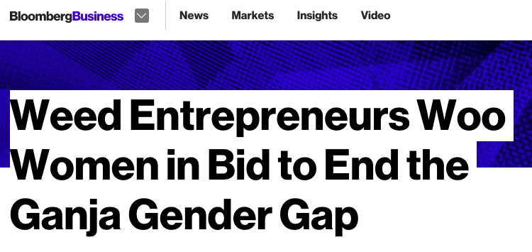
Media Reach
First Year Total Reach: 497 million total impressions
100+ placements in 13 months
4.6 million average impressions per placement
Robust coverage in publications covering a wide range of interests:
Business: International Business Times, Inc, Forbes, Fortune, MarketWatch, Bloomberg Business
News & Current Events: TIME, The Telegraph, LA Times, NPR
National politics: The National Journal, the Washington Times
Women's Interests: Bustle, Jezebel, Cake & Whiskey, Stylist UK
Lifestyle: VICE, New York Magazine
Cannabis: High Times, DOPE Magazine, The Cannabist (Denver Post), Marijuana Investor News, Marijuana Venture
Notes:
Top 3 Hits:
5/26/2015 - Debra Borchardt - Forbes (40,100,000 UMV) "Cannabis Companies Mirror Corporate America for Women"
4/20/2015 - Eliana Dockterman - TIME (16,000,000 UMV) The "Grass Ceiling: Women's Changing Role in Weed Culture"
6/2/2015 - Sara Davidson - Fortune (5,000,000 UMV) "High times: Behind the scenes at a women's pot conference"
7/16/2015 - Claire Boston - BloombergBusiness (21,201,677 UMV) "Weed Entrepreneurs Woo Women in Bid to End the Ganja Gender Gap"

Slide 9
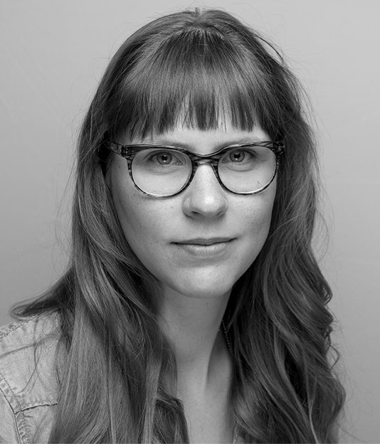
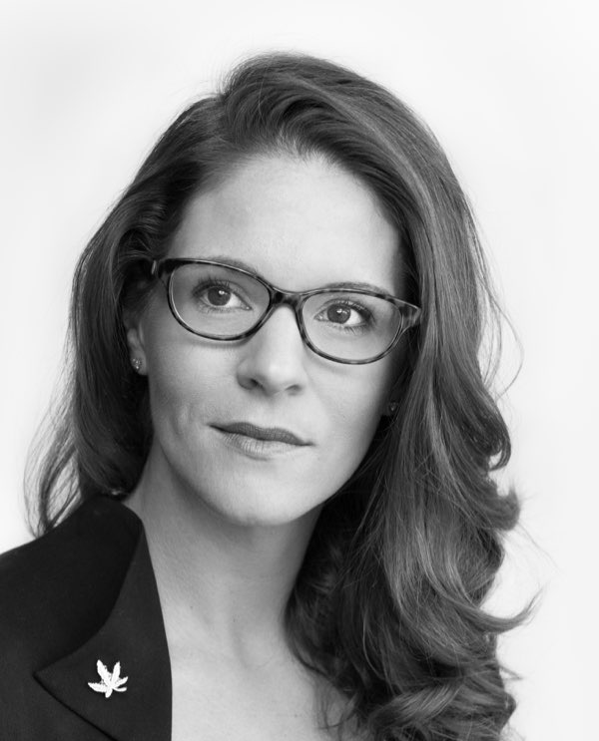
Founding Team
Jazmin Hupp
Executive Director
Previously Director at Women 2.0 &
Founder Labs
Entrepreneur in Tech, eCommerce & Retail
Julie Batkiewicz
VP of Partnerships
Customer Relationship Management Expert
Jane West
National Events Director
Owner, Edible Events Co.
Professional Development Event
Producer, Internationally Publicized Cannabis Event Producer
Notes:
Jazmin

Slide 10
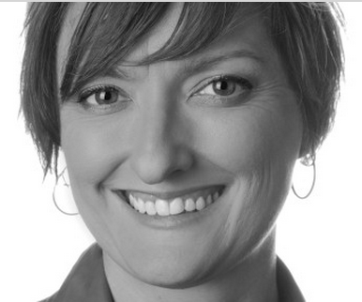
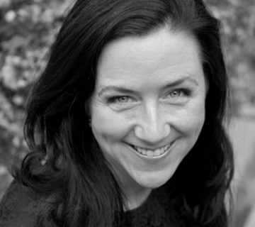
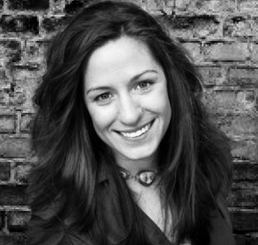
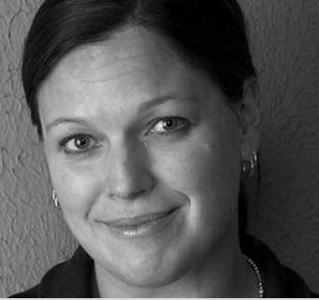
Advisory Board Highlights
Betty Aldworth
Students for Sensible Drug Policy
Executive Director of 300+ chapter network. Previously spokesperson for Colorado’s legalization campaign.
Maureen McNamara
Cannabis Trainers
Trained and certified 10,000+ employees, managers and owners in national certification programs. First cannabis trainer authorized in CO.
Sabrina Fendrick
NORML Women’s Alliance
Founder of largest women’s cannabis network & Director of Women’s Outreach. Currently at Berkeley Patient’s Group.
Rachel K. Gillette, Esq.
Veteran Cannabis Business Lawyer
Top 100 Most Influential People in the Cannabis Industry

Slide 15
Legal Disclaimer
THIS IS NOT AN OFFER TO SELL OR A SOLICITATION OF ANY OFFER TO BUY ANY SECURITIES. OFFERS ARE MADE ONLY BY LEGAL OFFERING MATERIALS AND CAN ONLY BE MADE TO QUALIFIED INVESTORS PURSUANT TO A REGISTERED OFFERING OR AN APPROPRIATE EXEMPTION THEREFROM.
INFORMATION HEREIN IS PRESENTED AS OF THE DATE HEREOF AND MAY CHANGE THEREAFTER.
CONFIDENTIAL

